Slide 1
ME 609
Optimization Methods in Engineering
Programming Project - Phase 2
Done by
Group 12:
Akshath Krishna R (210103012)
Joel Joseph A (210103060)

Slide 2
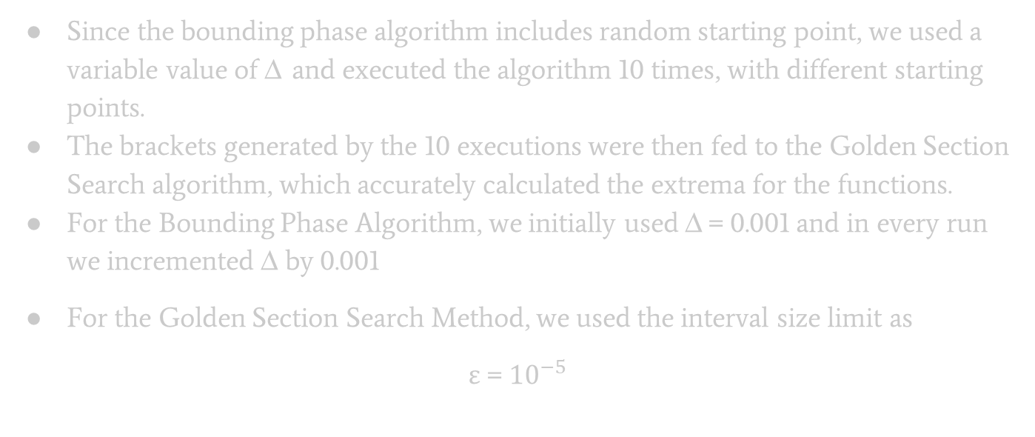
Input Parameters
Since the bounding phase algorithm includes random starting point, we used a variable value of Δ and executed the algorithm 10 times, with different starting points.
The brackets generated by the 10 executions were then fed to the Golden Section Search algorithm, which accurately calculated the extrema for the functions.
For the Bounding Phase Algorithm, we initially used Δ = 0.001 and in every run we incremented Δ by 0.001
For the Golden Section Search Method, we used the interval size limit as
ε = ${10}^{−5}$

Slide 3
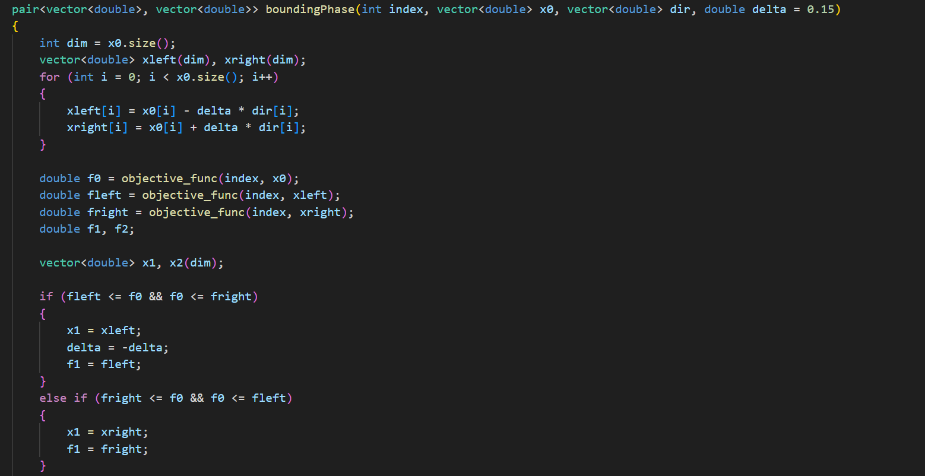
Code Snippet for Bounding Phase Algorithm(C++)

Slide 4
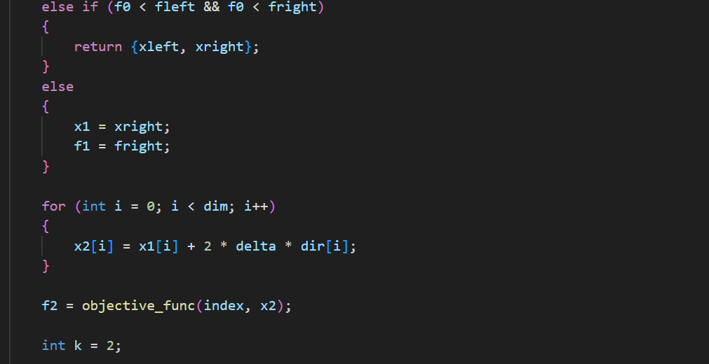
Code Snippet for Bounding Phase Algorithm(C++)

Slide 5
Code Snippet for Bounding Phase Algorithm(C++)

Slide 6
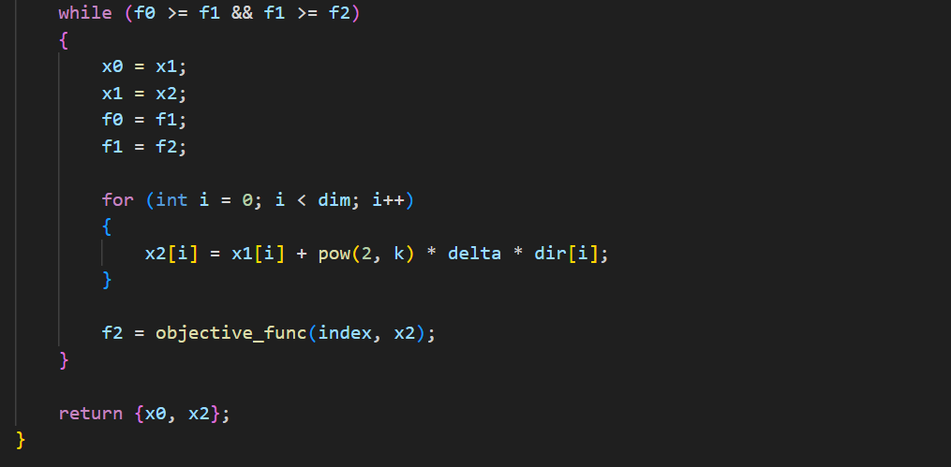
Code Snippet for Bounding Phase Algorithm(C++)

Slide 7
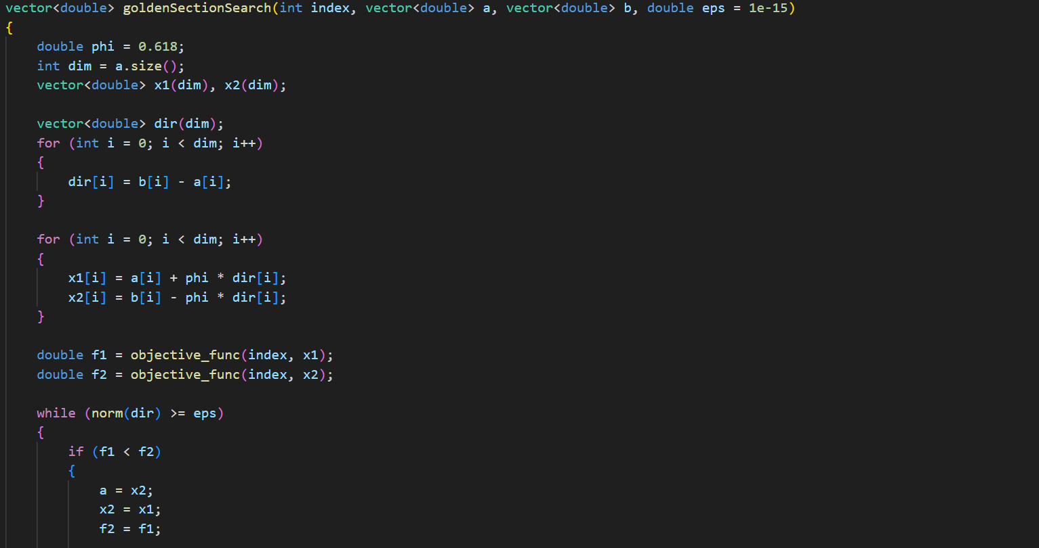
Code Snippet for Golden Section Search Algorithm

Slide 8
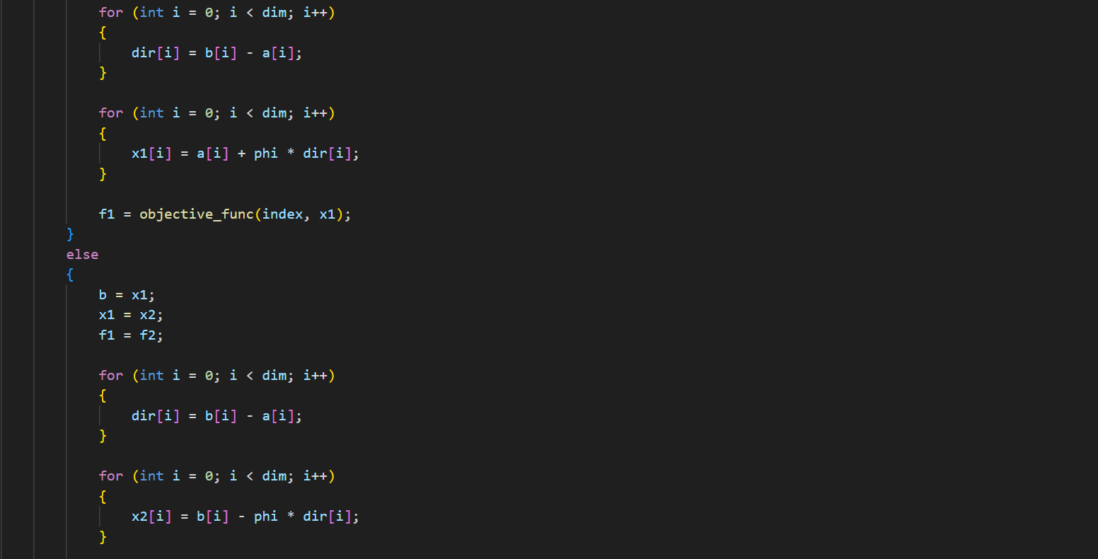
Code Snippet for Golden Section Search Algorithm

Slide 9
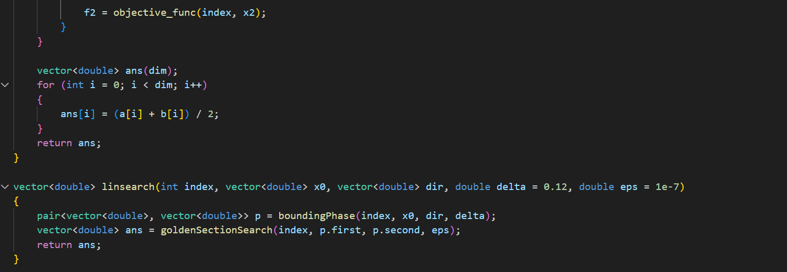
Code Snippet for Golden Section Search Algorithm

Slide 10
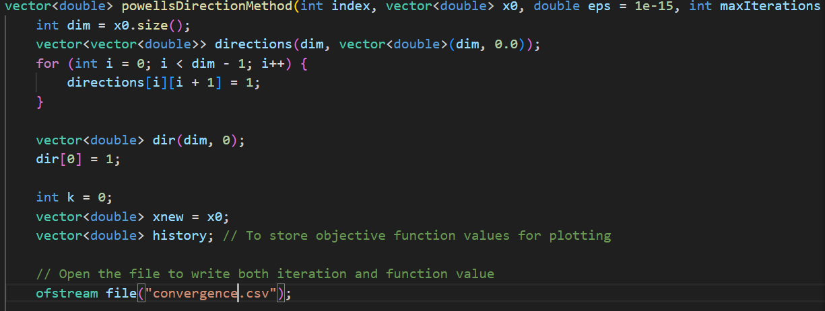
Code Snippet for Powell’s Conjugate Direction Algorithm

Slide 11
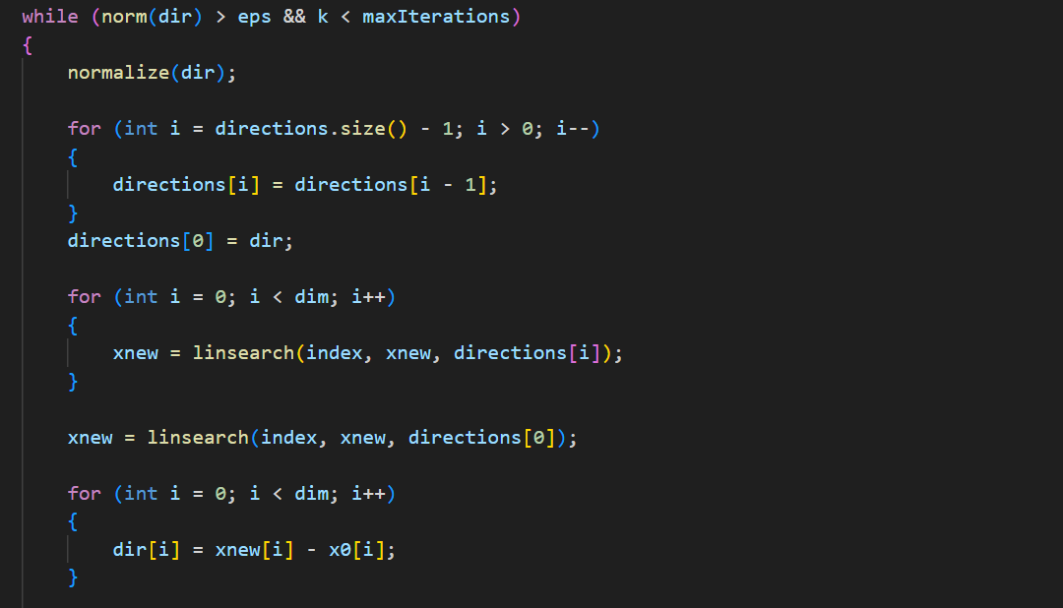
Code Snippet for Powell’s Conjugate Direction Algorithm

Slide 12
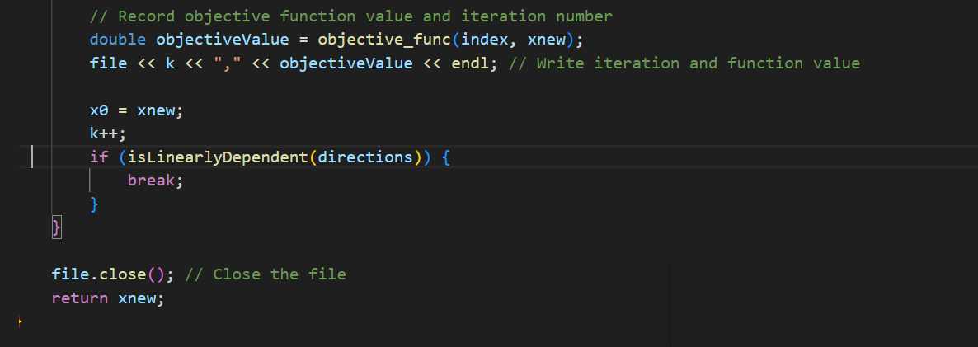
Code Snippet for Powell’s Conjugate Direction Algorithm

Slide 13
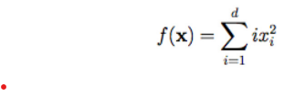
Results
Minimize the Sum Squares Function
in the interval [-5.12, 5.12] for 5 variables
Initial point is:
x0 = {-1.70667, -1.70667, -1.70667, -1.70667, -1.70667}
Optimized point is:
x_opt = {1.96147e-07, 7.74422e-08, 7.74422e-08, 7.74422e-08, -3.0859e-09}
f(x)=9.24971e-14, actual minima point = 0
Error = 9.24971e-14

Slide 14
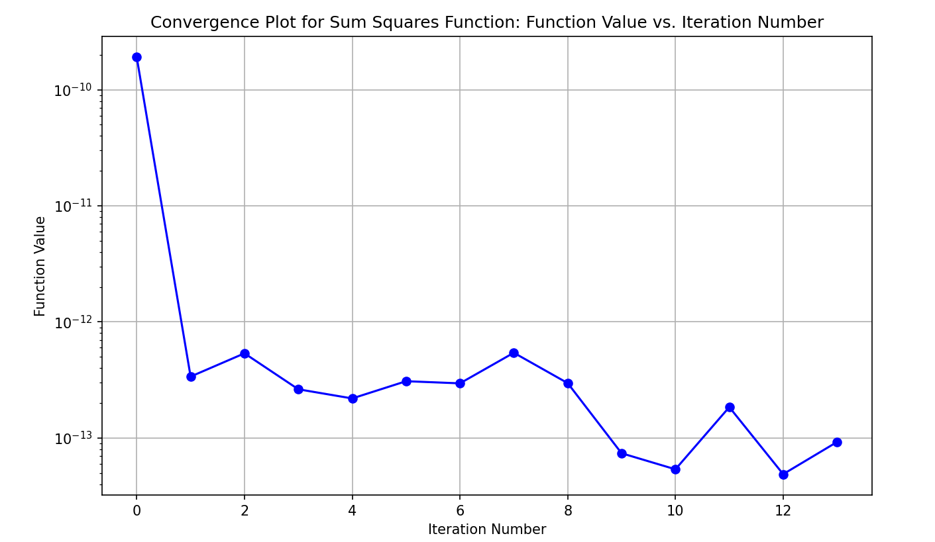
Convergence Plot

Slide 15
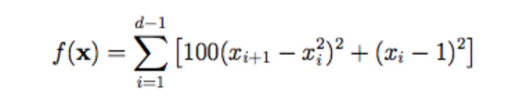
Results
2. Minimize the Rosenbrock Function
in the interval [-2.048, 2.048] for 3 variables
Initial point is:
x0 = {-0.682667, -0.682667, -0.682667}
Optimized point is:
x_opt = {1, 1, 1}
f(x)=1.10297e-11, actual minima point = 0
Error = 1.10297e-11

Slide 16
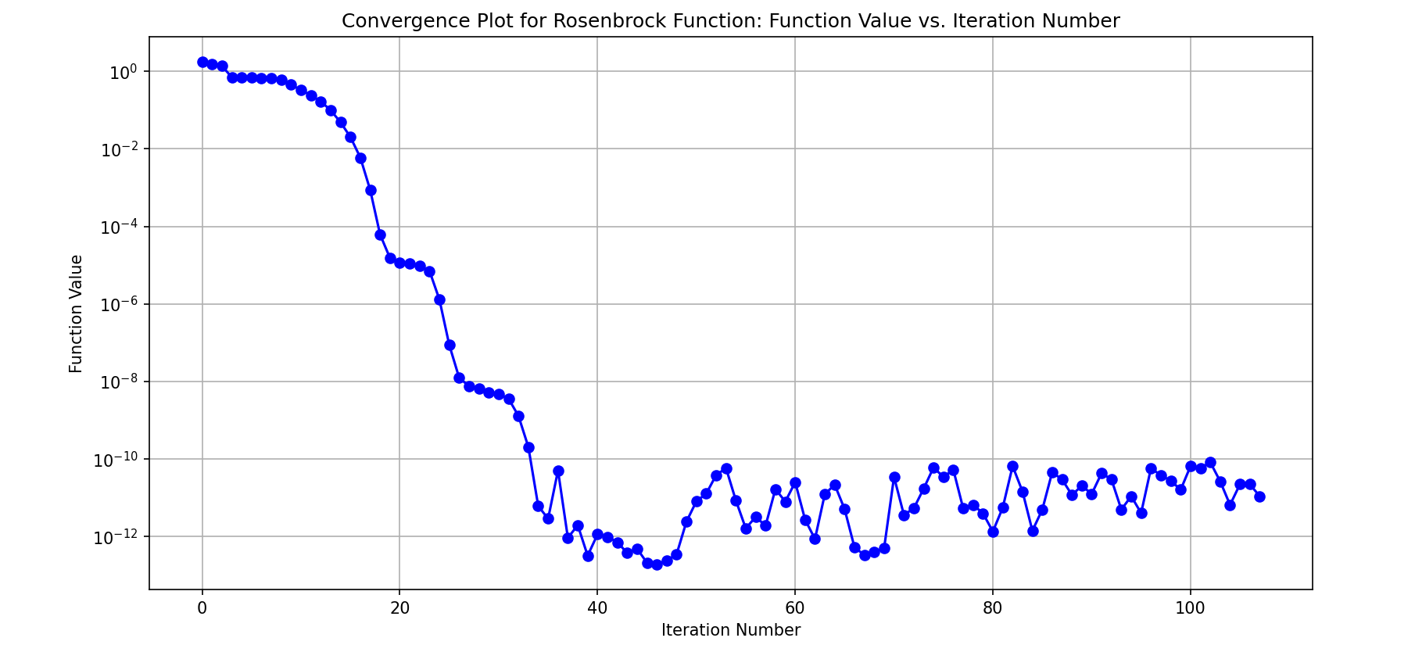
Convergence Plot

Slide 17

Results
Minimize the Dixon-Price Function
in the interval [-10, 10] for 4 variables
Initial point is:
x0 = {-3.33333, -3.33333, -3.33333, -3.33333}
Optimized point is:
x_opt = {1.00665, 0.710624, 0.598717, -0.552283}
f(x)=0.000697493, actual minima point = 0
Error = 0.000697493

Slide 18
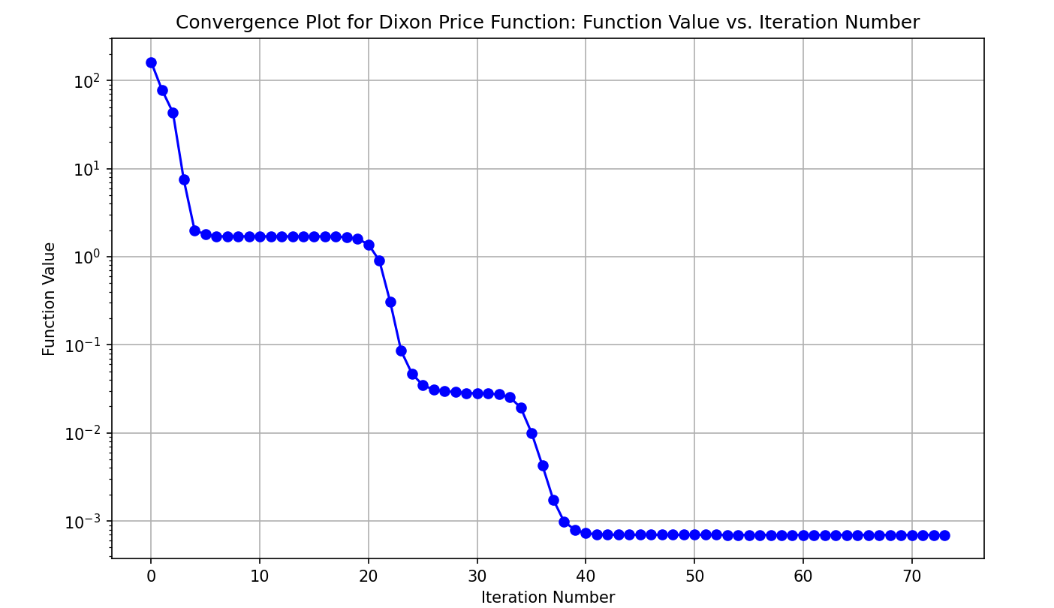
Convergence Plot

Slide 19

Results
4. Minimize the Trid Function
in the interval [-36, 36] for 6 variables.
Initial point is:
x0 = {-12, -12, -12, -12, -12, -12}
Optimized point is:
x_opt = {6, 10, 12, 12, 9.99999, 5.99999}
f(x)=-50, actual minima = -50 (-d(d+4)(d-6)/6) at xi = i(d+1-i) for all i = 1,2…,d Error = 0

Slide 20
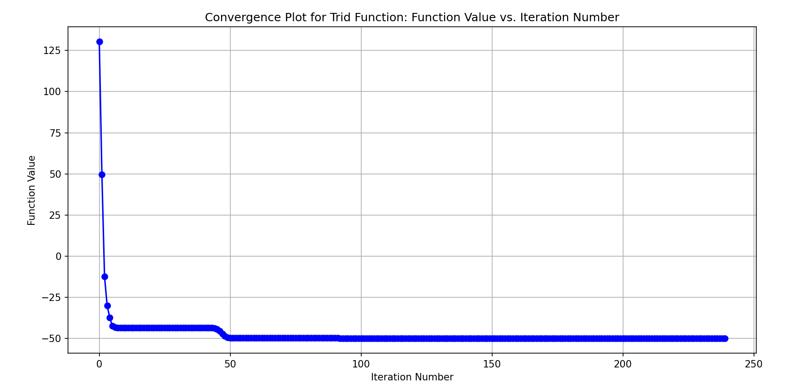
Convergence Plot

Slide 21

Results
5. Minimize the Zakharov Function
in the interval [-5, 10] for 2 variables
Initial point is:
x0 = {0, 0}
Optimized point is:
x_opt = {1.60297e-07, -9.65637e-09}
f(x)=3.07574e-14, actual minima = 0
Error = 3.07574e-14

Slide 22
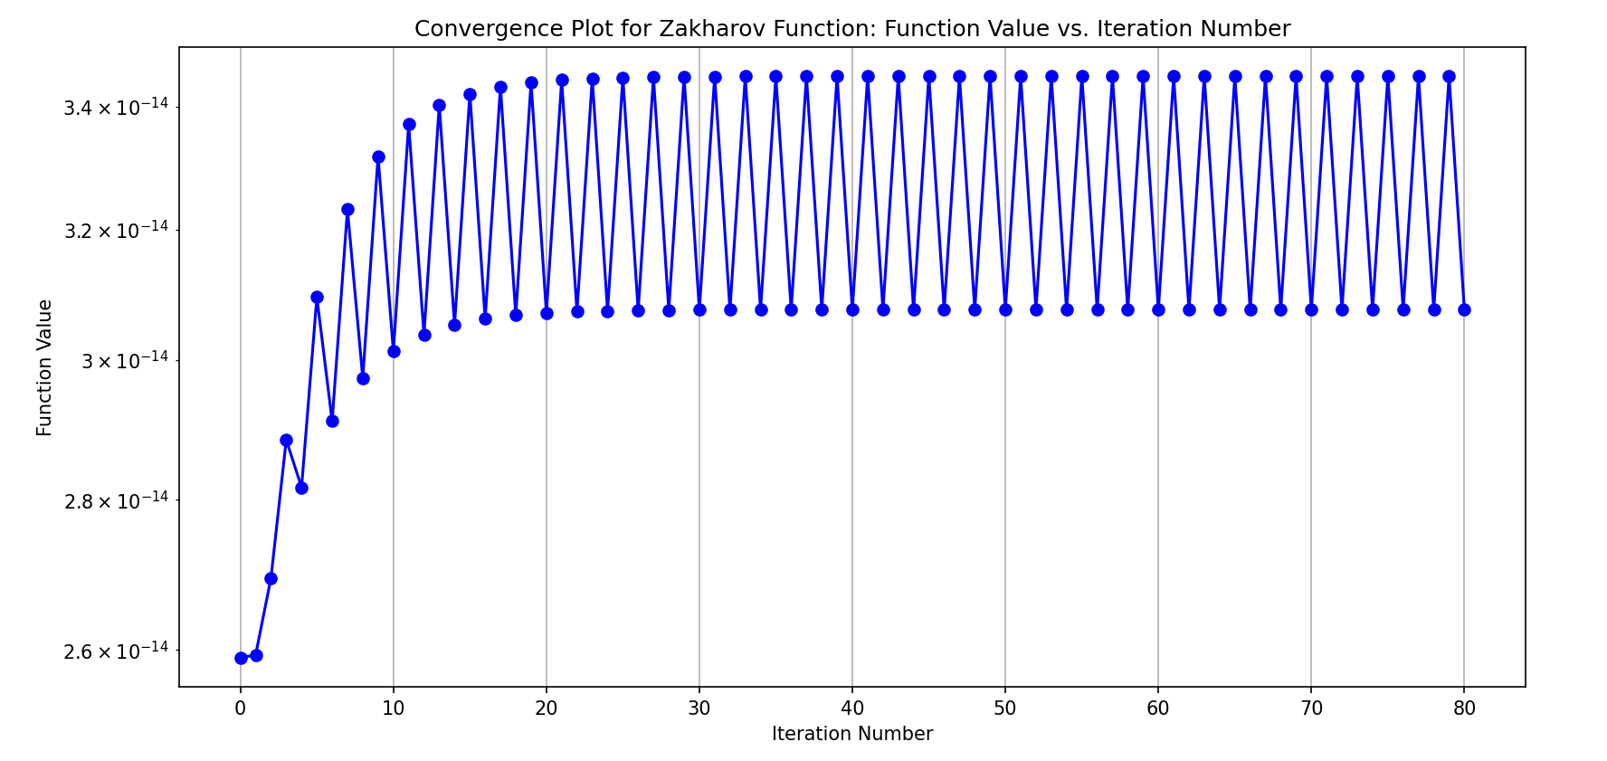
Convergence Plot

Slide 23
Results
SNo. | Bounding Phase |  |  |  |  | Golden Section Search
 | x₀ | Δ | x_{l} | x_{r} | Calls | Minima | Calls
1 | -5.28889 | 0.002 | -3.24289 | 2.90111 | 12 | 0.52706 | 28
2 | -4.68889 | 0.003 | -1.61989 | 7.59611 | 12 | 0.527061 | 29
3 | -4.08889 | 0.004 | -2.04489 | 4.09911 | 11 | 0.52706 | 28
4 | -3.48889 | 0.005 | -0.93389 | 6.74611 | 11 | 0.527059 | 29
5 | -2.88889 | 0.006 | -1.35889 | 3.24911 | 10 | 0.527058 | 28
6 | -2.28889 | 0.007 | -0.50389 | 4.87211 | 10 | 0.527061 | 28
7 | -1.68889 | 0.008 | -0.67289 | 2.39911 | 9 | 0.52706 | 27
8 | -1.08889 | 0.009 | -0.52189 | 1.20611 | 8 | 0.52706 | 26
9 | -0.48889 | 0.01 | 0.14111 | 2.06111 | 8 | 0.527059 | 26
10 | 0.11111 | 0.011 | 0.27611 | 0.80411 | 6 | 0.52706 | 23
5. Minimize
in the interval [-5, 10] for
2 variables.

Slide 24
Conclusion
As the value of Δ increases, the number of function call decreases.
For a larger value of Δ the range of bracketing method is more precise.
For the Golden Section Search Method, as the interval size limit increases the number of function call decreases.

Slide 25
Thank You

